Slide 1
Day01

Slide 2
Programming Paradigms :
1 . Linear/Sequential
2 . Structure
3 . OOP
Methods
—------------------------------------------------------------------------------------------------------------------------------------------------------------------------------------------------------------------------------------------------------------------
Data

Slide 3
C
Structure / Functional Programming
C++
Not Pure OOP
C#
Pure OOP

Slide 4
Pre Dot Net
Visual C++
Visual Basic
Delphi
Platform dependent
C++
Native Code
Machine Language
00101010101010101010101001101010101010
Compiler
GCC.exe
Helloworld.CPP
Helloworld.exe

Slide 5
With Dot Net 2002 :
Dot Net Framework:
Is a big container for software technologies like Web (ASP) , Mobile (Xamarin) , Desktop (WPF).
Consisting of 2 Components :
Base Class Library(BCL) of Technology
2. Common Language Runtime (CLR)
Dot Net Programming
Languages
Language Compilers
RunTime
Components
Roslyn
Visual Basic
Visual C++
C#
J# (Discontinued)
F#

Slide 6
.Net Code Compilation Steps
.Net Cross Languages :
VB
C#
F#
Platform Independent
Assembly File
C# Code
Managed Code
Runtime
Native
Compiler
CIL
IL
MSIL
JIT
Compiler
CSC.exe
Helloworld.CS
Helloworld.dll
Helloworld.exe
Compilation Time

Slide 7
Beginning of .Net Core
Mono Project - Mono Framework :
Parallel implementation for .net Framework [Mac , Linux]
.Net Core (Announced 2014 - Released 2016):
Cross Platform
Open Source
Component Based (Nuget.Org Package Manager [npm] )

Slide 8
Dot Net And C# Versions:
.Net Framework
.Net Core
Started :
.Net Framework 1.0 [2002] C# 1.0
Ended :
.Net Framework 4.8 [2019] C# 7.0
.Net Core 1.0 [2016]
.Net Core 3.1 [2019] C# 8.0
.Net Core 4.0 [2020]
XXX
.Net 5 [ Nov 2020] C# 9.0
.Net 6 [ Nov 2021] C# 10.0
.Net 7 [ Nov 2022] C# 11.0

Slide 9
Solution :
Solution
Container of Projects
Namespace
System.Windows.forms.button
System.Web.forms.button
Project
Web Application
Mobile Application
Desktop Application
C# Class Library
Web Application
Mobile Application
C# Class Library

Slide 10
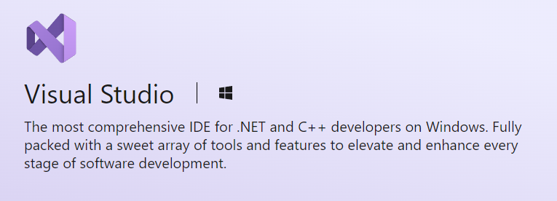
Visual Studio

Slide 11

Class Program
{
static void Main()
{
//Any Code
}
}

Slide 12
Comments
// single line of text
/* multiline
of text */

Slide 13


Errors
Syntax Error
Logical Error
Run Time Error
Warning

Slide 14
Declaring a Variable
Data Type
Name
Value
Address
int
x
5
1000

Slide 15
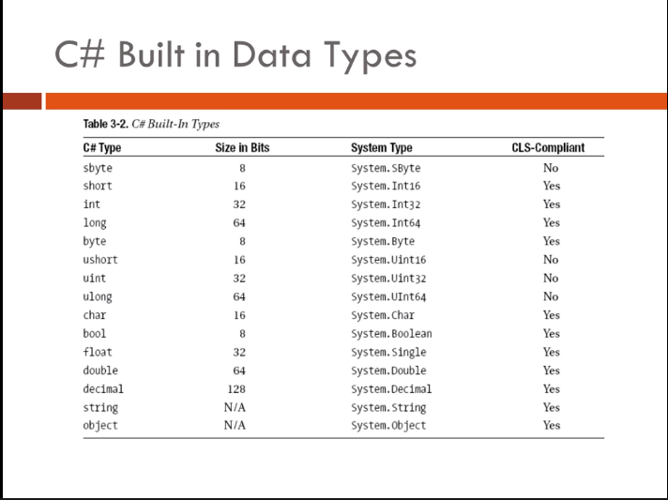

Slide 16
Common Type System (CTS)
Data Types in .Net Divided into 2 Categories :
VB
Value Type (Primitive)
CLS
2. Reference Type (Non Primitive)
F#
C#
CLS : Common Language Specification
Notes:
CTS (Common Type System):
CLR is all about types. Types expose functionality to your applications and other types. Types are the mechanism by which code written in one programming language can talk to code written in a different programming language. Because types are at the root of the CLR, Microsoft created a formal specification-the Common Type System (CTS)-that describes how types are defined and how they behave.
The CTS specification states that a type can contain zero or more members.
Field
Method
Property
Event
The CTS also specifies the rules for type visibility and access to the members of a type. The following list shows the valid options for controlling access to a member:
Private
Family (protected)
Family and assembly
Assembly (internal)
Family or assembly
Public
In addition, the CTS define the rules governing type inheritance, virtual methods, object lifetime, and so on. To help clarify this idea, let me give you an example.
The CTS allows a type to derive from only one base class so, while the C++ language supports types that can inherit from multiple base types, the CTS can't accept and operate on any such type. To help the developer, Microsoft's C++/CLI compiler reports an error if it detects that you're attempting to create managed code that includes a type deriving from multiple base types.
Another CTS rule all types must (ultimately) inherit from a predefined type:
System.Object. As you can see, Object is the name of a type defined in the System namespace. This Object is the root of all other types and therefore guarantees that every type instance has a minimum set of behaviors.
CLS (Common Language Specification):
COM allows objects created in different languages to communicate with one another. On the other hand, the CLR now integrates all languages and allows objects created in one language to be treated as equal citizens by code written in a completely different language. This integration is possible because of the CLR's standard set of types, metadata, and common execution environment.
While this language integration is a fantastic goal, the truth of the matter is that programming languages are very different from one another. For example, some languages don't treat symbols with case-sensitivity, and some don't offer unsigned integers, operator overloading, or methods to support a variable number of arguments.
If you intend to create types that are easily accessible from other programming languages, you need to use only features of your programming language that are guaranteed to be available in all other languages. To help you with this, Microsoft has defined a Common Language Specification (CLS) that details for compiler vendors the minimum set of features their compilers must support if these compilers are to generate types compatible with other components written by other CLS-compliant languages on top of the CLR.
The CLR/CTS supports a lot more features than the subset defined by the CLS, so if you don't care about interlanguage operability, you can develop very rich types limited only by the language's feature set. Specifically, the CLS defines rules that externally visible types and methods must adhere to if they are to be accessible from any CLS-compliant programming language. Note that the CLS rules don't apply to code that is accessible only within the defining assembly.

Slide 17
Value Type
[Primitive Data Types]
Reference Type
[Non Primitive Data Types]
Struct Enum Class Interface
User-Defined
Byte Sbyte 1 Byte
Short UShort 2 Byte
int Uint 4 Byte
Long Ulong 8 Byte
Object
String
Array
Delegate
Float 4 Byte
Double 8 Byte
Decimal 16 Byte
Built-in
Char 2 Byte
Bool 1 Byte
Datetime 8 Byte

Slide 18
Data Types
Value Type
int X ;
// Allocate 4 Uninitialized Bytes in Stack
BCL | C# Keyword
Byte | byte
Int16 | Short
Int32 | int
Int64 | Long
Single | float
Double | double
Decimal | decimal
String | string
Char | char
X = 4 ;
Int32 Y = 9 ;
Y 9
4
4 Byte
Y = X ; // 4
X
4
5
4 Byte
X ++; // 5
???
Console.Writeline(X);
//5
Stack
Console.Writeline(Y);
//4

Slide 19
Data Types
Class Point
{
int Y;
int X;
}
2. Reference Type
Point P1 ;
// Allocate 4 Bytes in Stack
// Zero Bytes Allocate at Heap
P1 = new point ( ) ;
// 1. Allocate Required Bytes at Heap
Unreachable
Object
// 2. Initialize (Cross Out) Allocated Bytes Of Object
P2
X
Y
0
0
// 3. Call User Defined Constructor If Exist
8
Bytes
// 4. Assign Reference (P1) To Allocated Object
Point P2 = new point ( ) ;
P1
0
0
9
0
X
Y
8
Bytes
P2 = P1 ;
P1.X = 9 ;
Stack
Heap
Console.writeline(P2.X);
// 9

Slide 20
Value Types Casting
Implicit Casting
Explicit Casting
Parse
Convert
Notes:
int x = 200000;
byte y = (byte)x;
and try to print y the result will be 64 oops??
int x = 200000;
byte y = checked((byte)x);
and try to run it will give an exception that the data will lost
another way to write ckecked keyword
int x = 200000;
byte y;
checked
{y = (byte)x;}

Slide 21
Operators
Unary
Binary
Assignment
Relational
Logical
Bitwise
Ternary
++
+
=
==
!
|
= ? :
--
-
+=
!=
&&
&
*
-=
>=
||
^
/
*=
<=
<<
%
/=
>
>>
%=
<

Slide 22
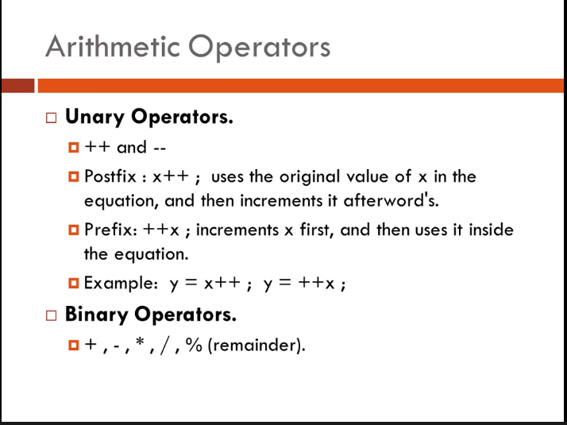

Slide 23
